Slide 1
Hello everyone,
Welcome to our presentation
01

Slide 2
Team members
Thanh Xuan-----Phi Nhung
Coming from class 11a1 & 11a4, Le Quy Don high school, Tuy Duc district, Dak Nong province.
02

Slide 3
Speaking Contest - Real Life English
School Year 2023-2024
0３

Slide 4
The halmful effects of smoking.
04

Slide 5
05

Slide 6
Some diseases caused by tobacco :
1
2
3
06

Slide 7
What is tobacco ?
07

Slide 8
08

Slide 9
Some toxic in cigarettes
09

Slide 10
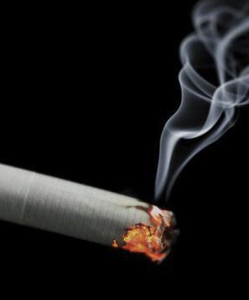
How harmful is tobacco?
For active smokers:
For passive smokers:
10

Slide 11
World Health Organization ( WHO ) estimates:
8 million people die from tobacco
Of these, 1 million people die from passive smoking
In Vietnam, 1 in 7 people die from tobacco
11

Slide 12
Smoking status of high school students
Cigarettes
E-Cigarettes
12

Slide 13
In 2019:
2.6% of students smoke e-cigarettes
Notes:
1

Slide 14
What to limit smoking?
14

Slide 15
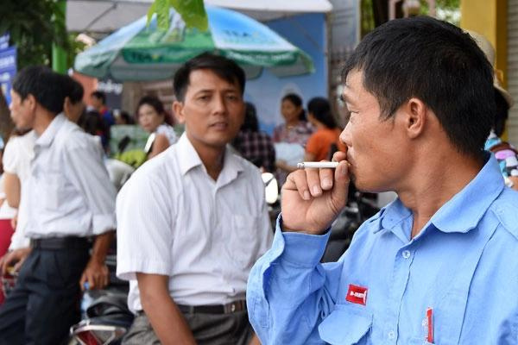
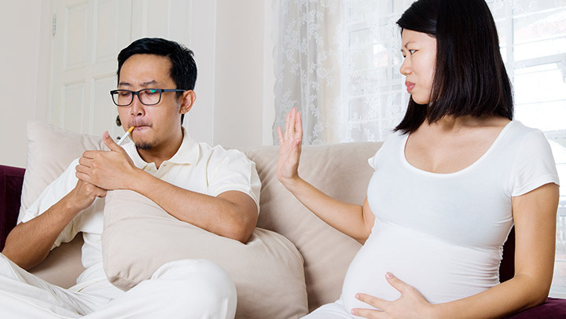
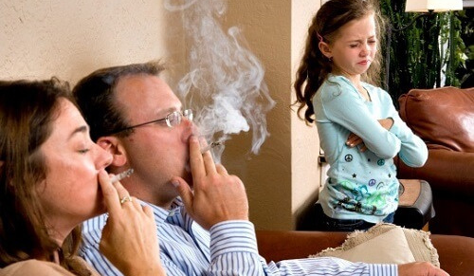
No smoking at :
15

Slide 16
16

Slide 17
THANKS FOR LISTENING TO OUR PRESENTATION.
18

