Slide 1
SPEAKING CONTEST -REAL LIFE ENGLISH
SCHOOL YEAR 2023-2024

Slide 2
Depression in students

Slide 3
WHAT IS THE DEPRESSION?

Slide 4
MAIN REASONS OF DEPRESSION.

Slide 5
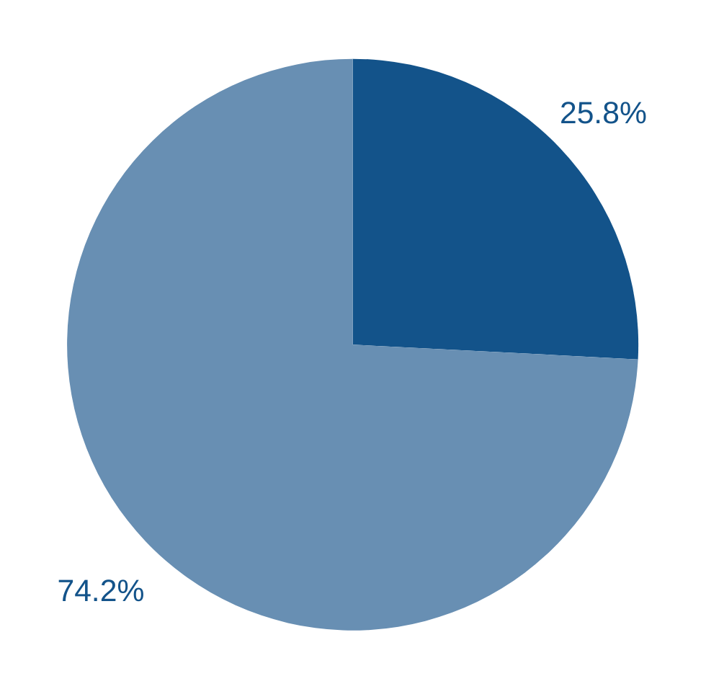
AT A SECONDARY SCHOOL

Slide 6
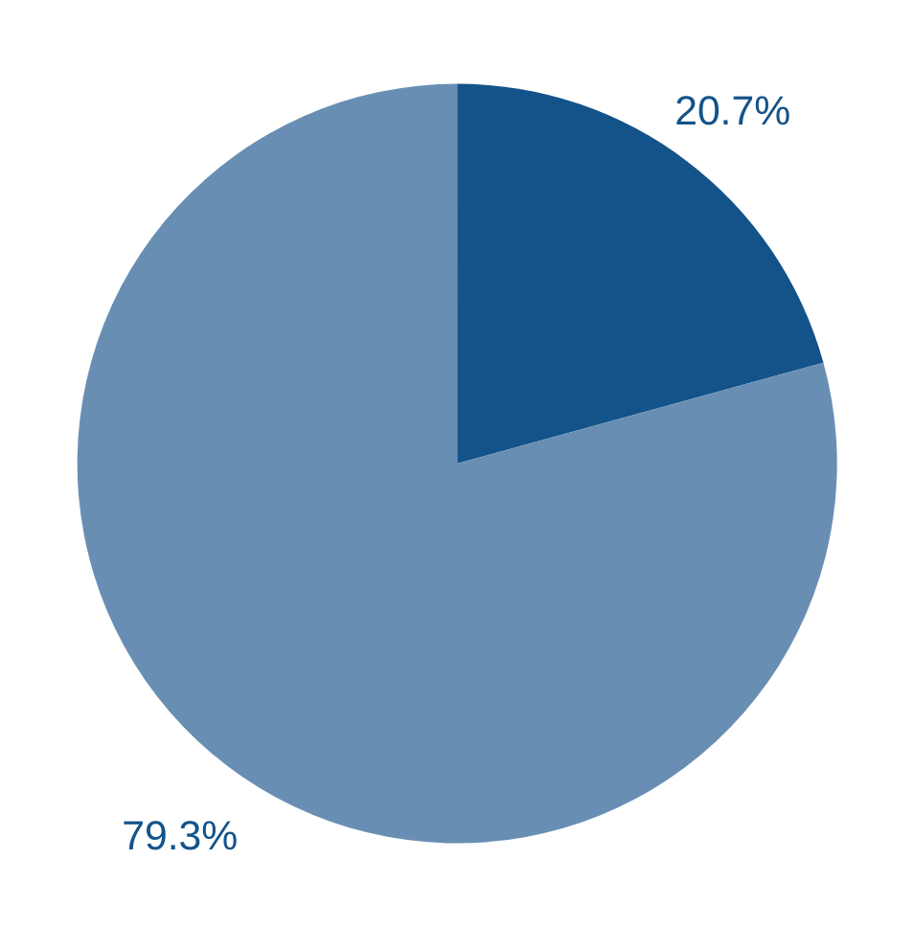
AT A SECONDARY SCHOOL

Slide 7
What happens inside"

Slide 8
CONSEQUENCES LEFT BY DEPRESSION.

Slide 9
Learn to manage our emotions?

Slide 10
To our mental health"

Slide 11
Thank you for listening

